Slide 1

GAME PROGRAMMING COURSE
WEEK 2
Unity Engine Fundamentals & Project Setup
Lecture 3 — Game Engine Overview & Unity Installation
Lecture 4 — Unity Project Setup & Editor Interface

Slide 2
This Week's Agenda
WEEK 2
01
Lecture 3
02
Lecture 4
Game Engine Overview & Unity Installation
Unity Project Setup & Editor Interface
▶ What is a Game Engine?
▶ Core Components of Game Engines
▶ Popular Game Engines Comparison
▶ Why Unity for This Course?
▶ Solar System Project Overview
▶ Project Goals & Learning Outcomes
▶ Download & Install Unity Hub
▶ Installing the Unity Editor
▶ Launching Unity for the First Time
▶ Creating a New Unity Project
▶ Understanding Project Templates
▶ Downloading Project Assets
▶ Importing Assets into Unity
▶ Asset Organization Best Practices
▶ Unity Editor Interface Overview
▶ Scene View, Game View & Windows
▶ Toolbar & Customizing Layout

Slide 3

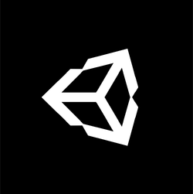
01
LECTURE 3
Game Engines & Unity Setup
Game Engine Overview, Solar System Project & Unity Installation

Slide 4
WEEK 2
What Is a Game Engine?
A game engine is a software framework designed to help developers build video games. It provides core functionality including rendering, physics, audio, scripting, and asset management — so developers can focus on creating gameplay rather than building technical systems from scratch.
Beyond Gaming
ANALOGY
Game engines now power industries far beyond entertainment:
■ Film & Animation — virtual production
■ Architecture — 3D visualizations
■ Automotive — prototyping
■ VR/AR — immersive experiences
Think of a game engine like a car chassis — it provides the frame, engine, wheels, and controls. You don't build a car from raw metal; you design the body, interior, and driving experience on top of a proven platform.
50%
190+
4.5B+
70%
of mobile games are built with Unity
countries have Unity developers
downloads of Unity-made games per month
of top mobile games use Unity

Slide 5
WEEK 2
Core Components of a Game Engine
Rendering Engine
Physics Engine
Audio System
Handles 2D/3D graphics, shaders, lighting, and visual effects. Converts 3D models and textures into the images you see on screen.
Simulates collisions, gravity, rigid bodies, and realistic motion. Makes objects behave naturally in the game world.
Manages sound effects, music, and spatial audio. Positional audio creates immersive 3D soundscapes.
Scripting System
Asset Management
Input Handling
Allows developers to program game behavior using languages like C#. Brings interactivity and logic to the game world.
Organizes and imports 3D models, textures, animations, and sounds. Keeps project resources structured and accessible.
Processes player input from keyboards, mice, controllers, and touchscreens. Bridges user actions to game responses.
These six systems work together to form the foundation of any game engine. Unity integrates all of these components into a single, cohesive environment — which is why understanding each system's role helps you become a more effective game developer.

Slide 6
WEEK 2
Popular Game Engines at a Glance
Engine | Primary Language | Best For | Key Strengths
Unity | C# | 2D/3D, Mobile, Indie | Cross-platform, large Asset Store, ~48% market share, beginner-friendly
Unreal Engine | C++, Blueprints | AAA, PC/Console, VR | Photorealistic graphics, Nanite/Lumen, free until $1M revenue
Godot | GDScript, C#, C++ | 2D, Indie, Open Source | Lightweight, completely free (MIT license), growing community
GameMaker | GML | 2D Games | Drag-and-drop + code, excellent for 2D, low learning curve
MARKET INSIGHT
Unity holds approximately 48% of the game engine market share, making it the most popular choice for indie developers and mobile game studios. Its cross-platform capabilities and extensive learning resources make it the ideal starting point for students entering game development.

Slide 7
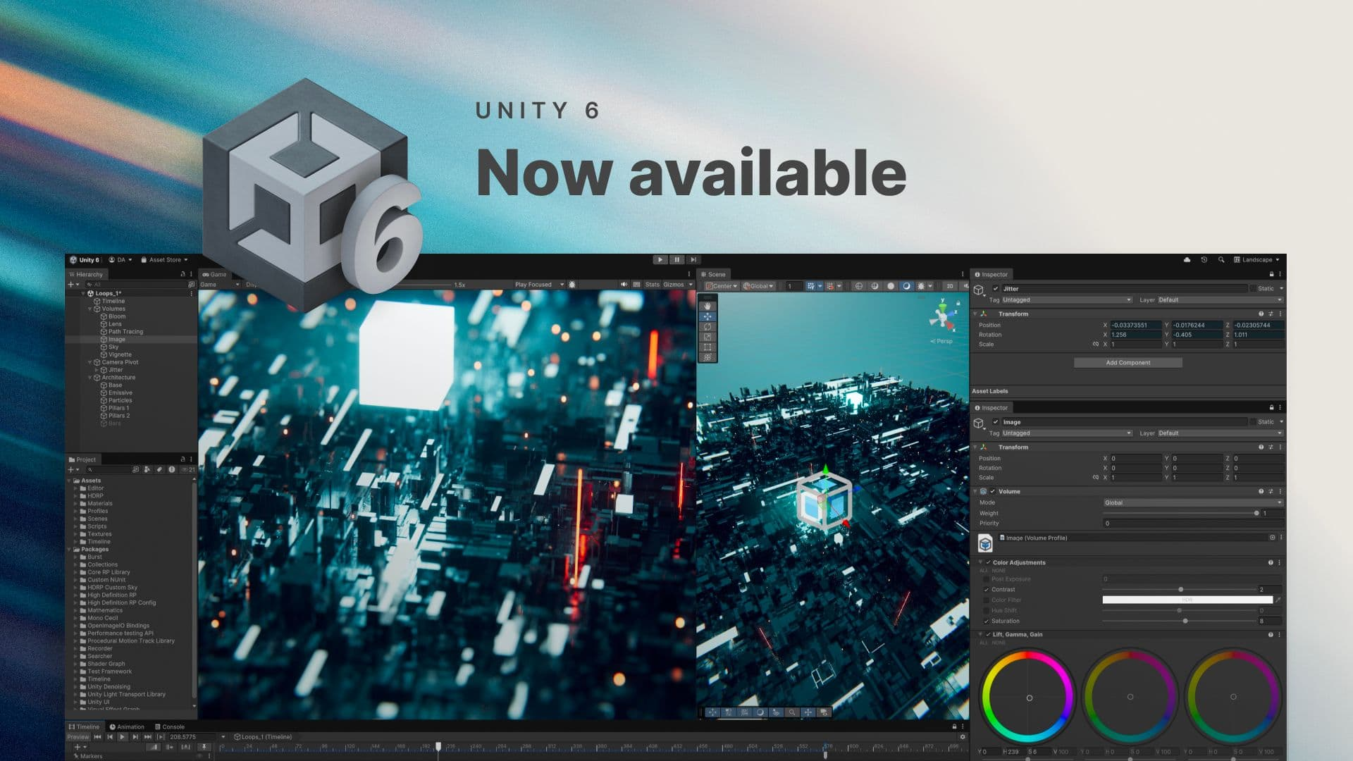
WEEK 2
Why Unity for This Course?
1
Cross-Platform Support
4
Industry Standard
Build for PC, Mac, mobile, web, and consoles from a single project.
Used by 50%+ of mobile games and countless indie/AAA studios.
2
Large Learning Community
5
Free Personal Tier
Extensive documentation, tutorials, forums, and community support.
Fully functional for learning and small projects. No watermarks.
3
Visual Editor + Code
6
Asset Store Ecosystem
Balance between drag-and-drop workflows and C# scripting.
Thousands of free and paid assets to accelerate development.

Slide 8
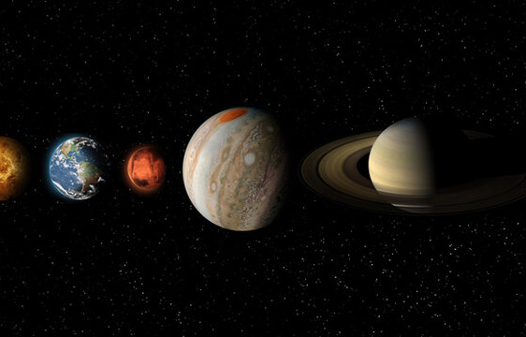
WEEK 2
Solar System Project — Overview
PROJECT BRIEF
The Solar System Project is your first hands-on assignment. You will build an interactive 3D simulation of our solar system in Unity, applying concepts from both lectures.
KEY FEATURES TO IMPLEMENT
■ Accurate planetary orbits and rotations around the Sun
■ Scaled planetary sizes and distances
■ Realistic textures for each planet
■ Interactive camera controls to explore the system
■ Animated planetary motion using C# scripts
SKILLS YOU WILL DEVELOP
▶ Navigate the Unity Editor
▶ Create 3D GameObjects
▶ Apply materials & textures
▶ Configure lighting & cameras
▶ Write C# control scripts
▶ Understand component architecture
▶ Use Hierarchy & Inspector
▶ Import external assets
▶ Organize project files

Slide 9
WEEK 2
Project Goals & Learning Outcomes
By completing the Solar System project, you will master the following Unity fundamentals:
01
Navigate the Unity Editor
02
Create and Manage 3D GameObjects
Confidently move between windows, use shortcuts, and customize your workspace.
Add, position, rotate, and scale objects in a 3D scene.
03
Apply Materials and Textures
04
Configure Lighting and Camera
Make 3D objects look realistic with surface properties and image textures.
Set up directional lights, ambient lighting, and camera perspectives.
05
Write C# Scripts
06
Understand Component Architecture
Program object behavior including orbital motion and rotation speed.
Learn how GameObjects use Components for flexible, modular design.
Success Tip: Each learning outcome maps directly to a skill needed for the Solar System project. Keep this page as a checklist — tick off each skill as you master it throughout the course.

Slide 10
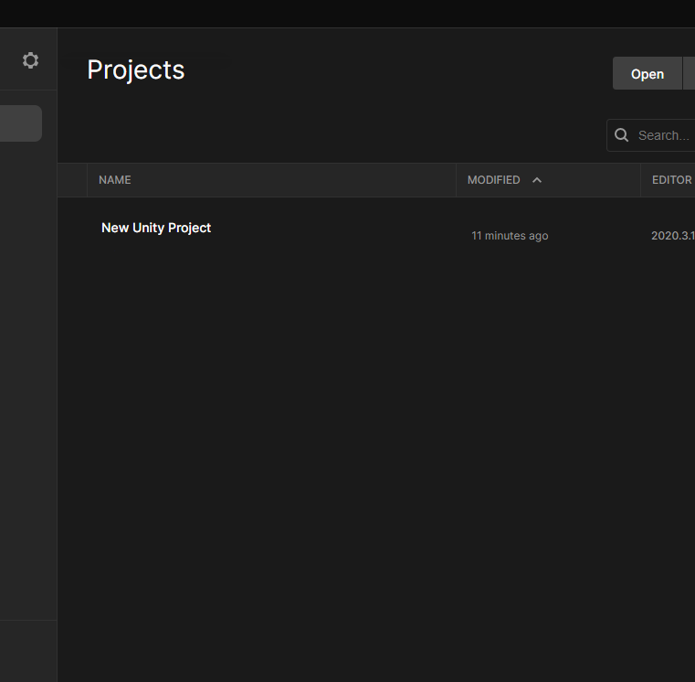
WEEK 2
Downloading Unity Hub — Step 1
1
Visit the Official Unity Website
Open your browser and navigate to unity.com/download
2
Download Unity Hub
Click "Download Unity Hub" for your OS (Windows/Mac/Linux). The installer is ~52MB.
WHAT IS UNITY HUB?
Unity Hub is a lightweight launcher that manages your Unity Editor installations, projects, and licenses — all in one central place.
SYSTEM REQUIREMENTS
OS: Windows 10/11, macOS 10.13+, Ubuntu 18.04+
CPU: SSE2 instruction set support
RAM: 8 GB minimum (16 GB recommended)
GPU: DX10/DX11/DX12 capable
Storage: 5 GB for Hub + Editor

Slide 11
WEEK 2
Installing Unity Hub — Step 2
1
Locate the downloaded installer in your Downloads folder
UNITY ID BENEFITS
2
Run the installer and accept the License Agreement
■ Access to Unity Editor and Hub
■ Unity Asset Store browsing
■ Community forums support
■ Learning platform access
■ Cloud build services
■ Analytics dashboard
■ Multiplayer hosting tools
■ Organization management
3
Choose an installation location with sufficient disk space
4
Complete the installation and launch Unity Hub
5
Create or sign in with your Unity ID account
6
Select Unity Personal (free) license tier
UNITY PERSONAL LICENSE
Free for individuals and small teams with revenue/funding under $200K in the past 12 months. Includes all core features with no watermarks.

Slide 12
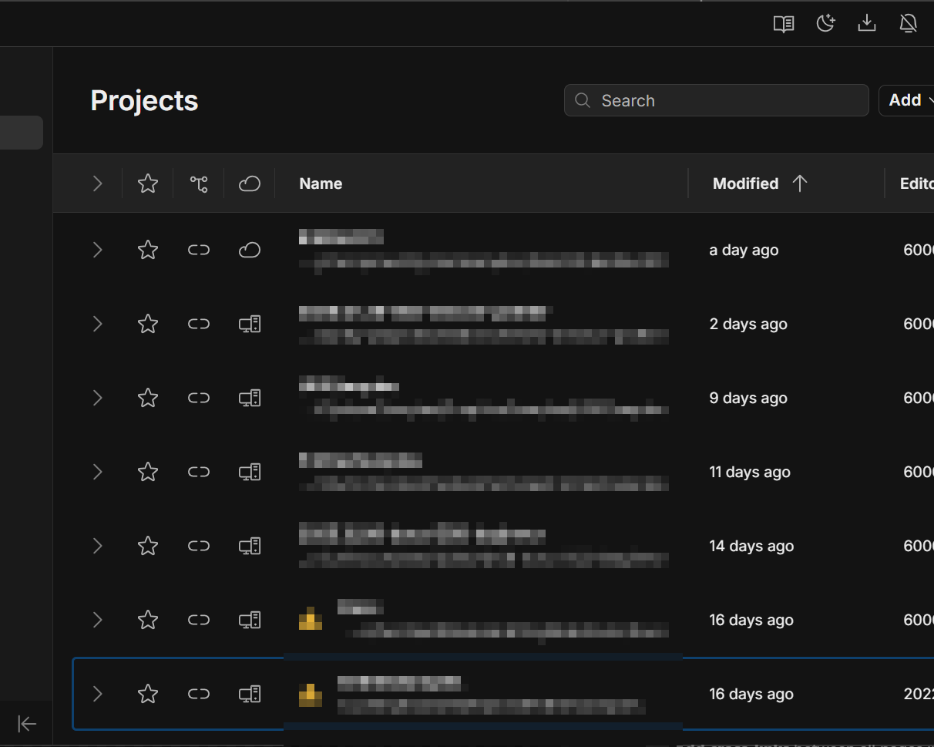
WEEK 2
Installing the Unity Editor — Step 3
1
In Unity Hub, go to the "Installs" tab
2
Click "Install Editor"
3
Choose the recommended LTS version
4
Click "Next" to proceed to module selection
5
Select your platform build support (Windows/Mac)
6
Optionally add Visual Studio Community
7
Click "Install" and wait (20-40 minutes)
WHY LTS VERSION?
LTS = Long-Term Support. Most stable version with 2+ years of bug fixes. Recommended for learning and production.

Slide 13
WEEK 2
Lecture 3 — Key Takeaways
LECTURE 3
A game engine provides rendering, physics, audio, scripting, and asset management systems
Unity is a cross-platform industry-standard engine ideal for learning game development
The Solar System Project will be your first 3D simulation in Unity
Unity Hub manages your Editor installations, projects, and licenses centrally
Install the latest LTS version with your platform's build support for stability
COMING UP
Lecture 4 — We will launch Unity, create your first project, import assets, and explore the Unity Editor interface in detail.

Slide 14

02
LECTURE 4
Unity Project & Editor
Project Setup, Asset Import & Editor Interface

Slide 15
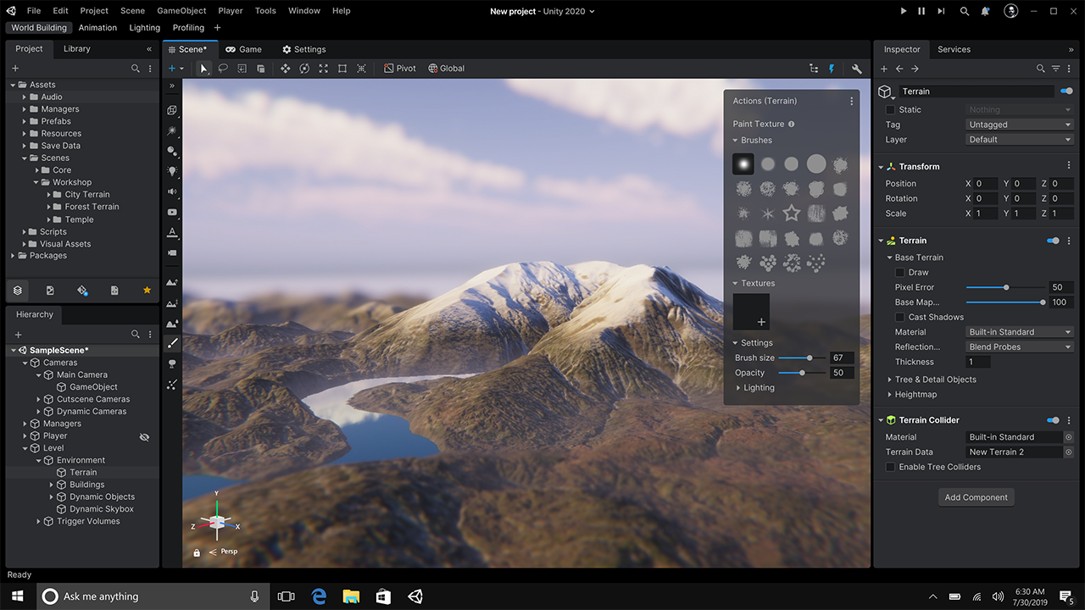
WEEK 2
Launching Unity for the First Time
1
Open Unity Hub from your desktop or Start menu
2
Go to the "Projects" tab — your project management center
3
All existing projects appear here with name, date, and version
4
First launch may take a few minutes to initialize — this is normal
PRO TIP
Reset to the default layout anytime via Window > Layouts > Default. This is useful if you accidentally rearrange windows.
DEFAULT LAYOUT WINDOWS
■ Scene View — interactive 3D workspace (center)
■ Game View — player preview (tabbed with Scene)
■ Hierarchy — scene object list (left)
■ Project — asset file explorer (bottom)
■ Inspector — object properties (right)

Slide 16
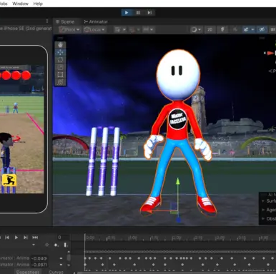
WEEK 2
Creating a New Unity Project
1
In Unity Hub, click "New Project"
2
Select "3D (Built-in Render Pipeline)" template
3
Enter a project name: "SolarSystem"
4
Choose a save location on your computer
5
Click "Create project"
6
Unity sets up the folder structure and opens the Editor
DEFAULT PROJECT FOLDERS
■ Assets/ — all your game files live here
■ Packages/ — dependencies and plugins
■ ProjectSettings/ — configuration files
■ Library/ — auto-generated cache (don't edit)
■ Logs/ — editor log files
■ Temp/ — temporary files (don't edit)

Slide 17
WEEK 2
Understanding Project Templates
Template | Best For | Description
3D (Built-in) | Learning, general 3D | Standard 3D using Unity's legacy renderer — our course choice for straightforward learning
3D (URP) | Performance, multi-platform | Universal Render Pipeline — optimized graphics that work well across all platforms
3D (HDRP) | AAA, PC/Console | High Definition Render Pipeline — photorealistic graphics for high-end hardware
2D (Built-in) | 2D games, sprites | 2D games using sprites, tilemaps, and 2D physics — ideal for platformers and puzzlers
2D (URP) | 2D with modern rendering | 2D projects with the Universal Render Pipeline for better performance and effects
OUR COURSE CHOICE
3D (Built-in Render Pipeline)
We use the 3D Built-in template because it provides the most straightforward learning experience. It has the simplest setup, widest compatibility with tutorials, and teaches core 3D concepts without the complexity of custom render pipelines. Once you master the basics, transitioning to URP or HDRP is easy.

Slide 18
WEEK 2
Downloading Project Assets
For the Solar System project, you will need planetary textures and visual assets. Here are the main sources:
Unity Asset Store
NASA 3D Resources
Built into Unity. Thousands of free and paid assets including space textures, planet models, and skyboxes.
Publicly available space textures and 3D models from NASA. Visit nasa3d.arc.nasa.gov
Kenney.nl
OpenGameArt.org
Free game assets including space-themed collections. CC0 license — use without attribution.
Community-contributed free game assets. Various licenses — check before using in projects.
INSTRUCTOR NOTE
For this course, project assets will be provided by the instructor. Download the asset package from the course website and save it to a location you can easily find.
The package will include planetary textures, skybox materials, and any additional assets needed for the Solar System simulation.

Slide 19
WEEK 2
Importing Assets into Unity
METHOD 1
METHOD 2
METHOD 3
Drag and Drop
Copy to Assets Folder
Import Package
Simply drag files from your file explorer directly into the Project window. Unity automatically copies them to the Assets folder and imports them.
Place files directly in the project's Assets folder on your computer. Unity detects new files and imports them automatically.
Double-click .unitypackage files, or use Assets > Import Package > Custom Package to import bundled assets.
SUPPORTED FILE FORMATS
3D Models
Textures & Images
Audio
Other
FBX, OBJ, 3DS, DAE
BLEND (Blender)
MAX, MAYA (via FBX)
PNG, JPG, TIFF, PSD
TGA, BMP, GIF
HDR, EXR (skyboxes)
WAV, MP3, OGG
AIF, MOD, IT, S3M
XM (tracker formats)
C# Scripts (.cs)
Shaders (.shader)
Animations (.anim)
Each asset type has configurable import settings in the Inspector. Select any asset in the Project window to view and adjust its import parameters.

Slide 20
WEEK 2
Asset Organization Best Practices
Proper organization prevents chaos as your project grows. Create this folder structure inside Assets/:
Materials/
Scripts/
Shaders, material files, and surface properties
C# script files and code
Models/
Textures/
3D models, meshes, and imported geometry
Image files, textures, and skyboxes
Prefabs/
Audio/
Reusable object templates and pre-configured assets
Sound effects, music, and audio clips
Scenes/
Saved scene files (.unity)
NAMING CONVENTIONS
✓ Use descriptive names
PlayerController.cs (not script1.cs)
✓ Use PascalCase for scripts
PlanetRotation.cs, SunMaterial.mat
✓ Avoid spaces in filenames
Use underscores or camelCase instead
✓ Keep a consistent structure
From day one — don't postpone organization

Slide 21
WEEK 2
Unity Editor Interface — The Big Picture
SCENE VIEW
GAME VIEW
1
Scene View
Your interactive 3D workspace for building
2
Game View
HIERARCHY
INSPECTOR
Preview of how your game will look played
3
Hierarchy Window
Lists all GameObjects in the current scene
4
Project Window
File explorer for all assets in your project
PROJECT
5
Inspector Window
Displays and edits properties of selections
These five windows work together to give you complete control over your project. The Scene View and Game View occupy the center, the Hierarchy and Inspector flank the sides, and the Project window sits at the bottom. Mastering their interactions is key to efficient Unity workflow.

Slide 22
WEEK 2
Scene View & Game View
Scene View
Game View
The main interactive 3D viewport where you build and edit your game world.
Shows exactly what the player will see when the game runs.
NAVIGATION
CONTROLS
Alt + Left Click — Orbit around the scene
Right Click — Fly mode (WASD + mouse)
Scroll Wheel — Zoom in and out
F key — Frame selected object
Play button (▶) — Start game preview
Pause (⏸) — Freeze gameplay
Step (⏭) — Advance frame by frame
Aspect ratio — Simulate screen sizes
IMPORTANT
Changes made in Play mode are not saved! If you edit objects while playing, those changes will be lost when you exit Play mode.
TRANSFORM TOOLS
Q Hand (pan view) | W Move (translate) | E Rotate | R Scale | T Rect Transform | Y Transform
These are the most frequently used shortcuts in Unity. Memorize Q, W, E, R for instant productivity.

Slide 23
WEEK 2
Hierarchy Window
What Is the Hierarchy?
EXAMPLE HIERARCHY
The Hierarchy window lists every GameObject in the current active scene. GameObjects are the fundamental building blocks — cameras, lights, 3D models, UI elements, and more.
▼ SolarSystem (scene root)
▼ Sun (parent)
● SunMesh
● SunLight
▼ Planets (parent)
● Mercury
● Venus
● Earth
● Mars
● Jupiter
● Saturn
● Uranus
● Neptune
● MainCamera
● DirectionalLight
KEY FEATURES
■ Parent-child relationships — moving a parent moves all children
■ Search bar — quickly find objects by name
■ Right-click menu — create new GameObjects
■ Visibility toggle — eye icon to show/hide
■ Selectability toggle — hand icon to lock
■ Drag to reorder — rearrange objects anytime
★ Tip: Use empty GameObjects as "folders" to group related objects. For the Solar System, create a "Planets" parent object.

Slide 24
WEEK 2
Project Window
What Is the Project Window?
EXAMPLE PROJECT STRUCTURE
The Project window is your asset file explorer. It displays the contents of your project's Assets folder, organized in a folder structure you create.
▼ Assets
▼ Materials
● SunMaterial.mat
● EarthMaterial.mat
▼ Scripts
● PlanetRotation.cs
● CameraController.cs
▼ Textures
● sun_texture.jpg
● earth_texture.jpg
▼ Scenes
● SolarSystem.unity
▼ Prefabs
● PlanetPrefab.prefab
KEY FEATURES
■ Two-pane layout — folders (left), contents (right)
■ Favorites — quick access to common folders
■ Search & filter — by name, type, or label
■ Drag to scene — drag assets into Scene/Hierarchy
■ Create assets — right-click to create new files
★ Key distinction: The Project window contains ALL assets available to your project. The Hierarchy only shows objects currently in the active scene.

Slide 25
WEEK 2
Inspector Window
The Inspector shows detailed information about whatever you have selected. It is context-sensitive — the contents change based on your selection.
When a GameObject is selected
When an asset is selected
■ Shows all attached Components
■ Transform — Position, Rotation, Scale
■ Mesh Renderer — 3D model display
■ Collider — physics collision shape
■ Scripts — C# behavior components
■ Add/Remove/Reorder components
■ Shows import settings
■ Preview of the asset
■ File path and type info
■ Format-specific options
■ Debug mode reveals internal values
■ Edit values in real-time
THE TRANSFORM COMPONENT
Every GameObject has a Transform component. It is the most frequently edited component in Unity:
Position (X, Y, Z) — location in 3D space | Rotation (X, Y, Z) — orientation in degrees | Scale (X, Y, Z) — size multiplier

Slide 26
WEEK 2
Toolbar & Editor Controls
Transform Tools
Transform Gizmos
Play Controls
Q — Hand Tool (pan view)
W — Move Tool (translate)
E — Rotate Tool
R — Scale Tool
T — Rect Transform
Y — Transform Tool
Pivot / Center — toggle reference point
Local / Global — coordinate space
Local = object's own axes
Global = world axes (fixed)
▶ Play — start game preview
⏸ Pause — freeze gameplay
⏭ Step — advance one frame
Center of the toolbar
ESSENTIAL KEYBOARD SHORTCUTS
Ctrl + S — Save scene
Ctrl + Z — Undo
Ctrl + Shift + Z — Redo
Ctrl + D — Duplicate
Ctrl + N — New scene
F — Frame selected object
Q W E R — Transform tools
Space — Maximize window
Ctrl + P — Play/Stop
Ctrl + 1/2/3 — Layout presets
Delete — Remove selected
Ctrl + G — Group objects
Shift + Space — Toggle maximize
Alt + Click — Orbit camera
Ctrl + Shift + N — New empty GO

Slide 27
WEEK 2
Customizing Your Editor Layout
Unity's flexible layout system adapts to your workflow. Customize it to match your personal preferences:
HOW TO CUSTOMIZE
BUILT-IN LAYOUTS
■ Drag any window tab to dock in a new position
■ Create floating windows by dragging outside the dock
■ Save layouts via Layout > Save Layout
■ Switch layouts from the Layout dropdown
■ Reset to default via Window > Layouts > Default
■ Default — balanced, recommended for beginners
■ 2 by 3 — more vertical space for Scene view
■ 4 Split — four simultaneous views
■ Default — good general-purpose layout
■ Tall — maximizes vertical screen use
PRODUCTIVITY TIPS
★ Use a dual-monitor setup? Drag the Game view to a second screen for real-time preview while editing in the Scene view.
★ Collapse windows you don't frequently use to maximize workspace. You can always reopen them from the Window menu.

Slide 28
WEEK 2
Lecture 4 — Key Takeaways
LECTURE 4
Create new projects via Unity Hub using the 3D Built-in template
Import assets by drag-and-drop, copying to Assets folder, or importing packages
Organize assets with a clear folder structure from the start of your project
Scene View is your 3D workspace, Game View is your player preview
Hierarchy shows scene objects, Project shows all available assets
Inspector edits properties of selected objects and assets
YOU ARE READY
You now have Unity installed and understand the Editor. Time to start building!

Slide 29
GAME PROGRAMMING — WEEK 2
Ready to Build Your Solar System
You now have Unity installed and understand the Editor.
Next week: building planets, orbits, and C# scripting.
Week 3 Preview: 3D GameObjects, Materials & Lighting
Keep exploring and see you next class!

